Slide 1
29 – Clean Code – Design Patterns – SMC Parser
Based on the CleanCoders videos by Uncle Bob Martin
Rupert Waldron

Slide 2
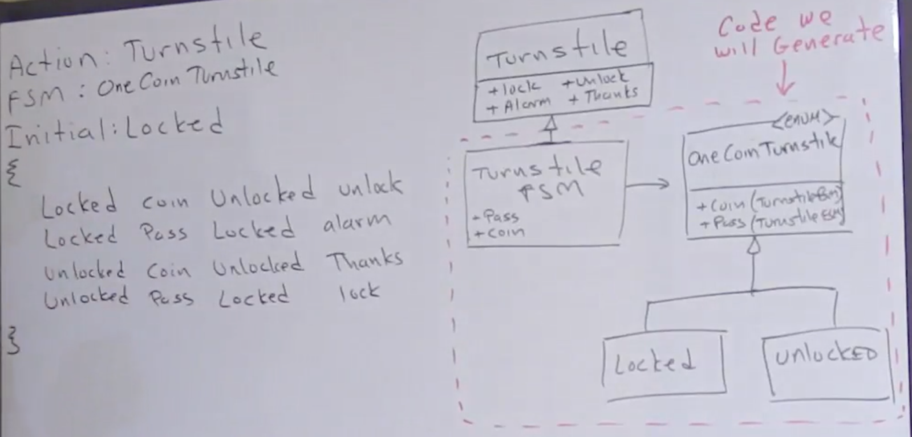
State Machine Compiler (SMC) - Parser
Here we aim to generate our state machine for the turnstile from our state table

Slide 3
State Machine Compiler (SMC) - Parser
Now we have the specification, we can create a formal spec using Backus-Naur Form – BNF.

Slide 4
Backus–Naur form (BNF)
Backus-Naur form is a metasyntax often used to describe the syntax of languages
//OneCoin
Actions: Turnstile
FSM: OneCoinTurnstile
Initial: Locked
{
Locked {
Coin Unlocked {alarmOff unlock}
Pass Locked alarmOn
}
Unlocked {
Coin Unlocked thankyou
Unlocked Pass Locked lock
}
}
FSM::=<Header>*<Logic>
<Header> ::= <Name> “:” <Name>
<Logic> ::= “{“ <Transition>* “}”
<Transition> ::= <State> “{“ <State-Spec> “}”
<State> ::= <Name>
<State-Spec> ::= <Event> ” ” <State> ” ” <Action>
<Event> ::= <Name>
<Action> ::= <Name> | “{“ <Name> “ ” <Action> “}”
<Name> ::= \w+
Headers

Slide 5
The BNF of the FSM leads to the definition of data structures
Data structures don’t care about “{“ or spellings
public class FsmSyntax { public List<Header> headers = new ArrayList<>(); public List<Transition> logic = new ArrayList<>(); public List<SyntaxError> errors = new ArrayList<>(); public boolean done = false; public static class Header { public String name; public String value; public static Header NullHeader() { Header header = new Header(null, null); return header; } public Header() { } public Header(String name, String value) { this.name = name; this.value = value; }
public static class Transition { public State currentState; public Event event; public State nextState; public List<Action> actions = new ArrayList<Action>(); } public static class State { public String state; public State(String state) { this.state = state; } } public static class Event { public String event; public Event(String event) { this.event = event; } }

Slide 6
Lexical Analysis – Parsing our structure
Any system that can be represented in BNF can be parsed with a finite state machine
you can implement a parser by implementing the right finite state machine
Create the Lexer and then parse the structure string to create the data structures

